Slide 1


Graph Exploration
September 2019
Paolo Trilli
Parallel Programming
POLITECNICO DI MILANO

Slide 2

Problem description
Parallel Programming
2
Graph(N,E) =
4
6
1
Current level =
3
4
2
1
5
5
3
8
7
1
3
2
2
3
4
3
4
Levels[N] =
POLITECNICO DI MILANO

Slide 3

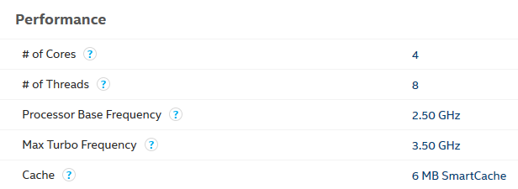
Hardware Specifications
Parallel Programming
POLITECNICO DI MILANO

Slide 4

Compiler Specifications
Parallel Programming
POLITECNICO DI MILANO

Slide 5
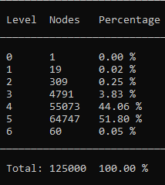
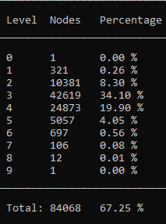
Graph structure
Parallel Programming
ER graph
Erdős-Rényi model, or uniformly random:
this model uniformly and randomly picks M pairs of nodes out of N nodes and creates edges between them.
RMAT graph
RMAT model which produces a so-called scalefree graph, characterized by its skewed degree distribution and fractal community structure.
Both of our generators came from a graph library called SNAP.
For the parameters of the RMAT graph have been used default values.
POLITECNICO DI MILANO

Slide 6
Parallel graph import
Parallel Programming
SHARED MEMORY
MAIN THREAD
THREADS
Read from file
.txt
QUEUE
pop()
Pop from queue
Push in queue
push()
bool[][] graph
Insert into table
POLITECNICO DI MILANO

Slide 7
Parallel graph import performances
Parallel Programming
ER graph:
125k nodes
1M edges
Undirected (for each edge read from file, there are two arcs that must be written in the table
RMAT graph:
125k nodes
1M arcs
Directed
POLITECNICO DI MILANO

Slide 8
General implementation
Parallel Programming
Given a graph G(N,E) where N is #nodes and E is #edges, there are some data structures common to all the different methods:
bool* graph = new bool[N*N] → is the representation of the graph, if an arc connecting node i to j, then graph[i*N + j] will be true.
bool* visited = new bool[N] → for each node it tells if it has been already visited or not.
short int* lev = new short int[N] → if a node has been visited it stores the level of that node from the root.
graph is not saved as heap matrix to save memory (N*dimention(pointer)) and to have data stored sequentially in order to have less memory misses for large instances.
Used openMP to implement parallelization, because the only parts needed to be parallelized were for cycles (in document it uses fork and partition of data structures) and each thread is running the same code on different data.
POLITECNICO DI MILANO

Slide 9
Save without conflicts
Parallel Programming
#pragma omp parallel for
for (int j = 0; j < neighbours.size(); j++) {
int neigh = neighbours.at(j);
if (!visited[neigh]) {
visited[neigh] = true;
lev[neigh] = level + 1;
}
}
Warning! It can happend that more than one thread enters the if statement with the same neigh value!
It is really unlike to happend:
Graph used in the paper: G(N,E) with |N| = 32M and |E| = 256M
EsN = #Edges for single node (mean) = |E| / |N| = 8
%Nodes covered from a node = EsN * 100 / (N – 1) ≈ 0,000025 %
But it can still happend! Consequences:
Queue method:
The node will be added two times in the next queue so it will be processed two times at the next iteration. The second time it will be processed it will find all neighbours already set so it is only a waste of time.
Read method:
It writes two times the correct level in lev array, but there are no other side effects.
POLITECNICO DI MILANO

Slide 10
BFS methods implementation
Parallel Programming
Data structures:
current → stored the current nodes of the exploration
neighbours → stored all neighbours of the current node
next → stored only the nodes in neighbours that have not been visited yet
Sequential method:
queue<int> current
queue<int> next
queue<int> neighbours
Queue operations:
push(x) → inserts element x at the end
pop() → removes the first element
front() → access the first element
Queue method:
vector<int> current
vector<int> next
vector<int> neighbours
queue<int> private_next
Vector operations:
push_back(x) → adds element x to the end
at(i)→ access element at index i
Queue does not have a way to partition it, while with Vector it is trivial and easy to parallelize.
Read method:
vector<int> neighbours
Doesn’t need any additional data structure:
at each cycle the algorithm checks lev array, if a node has level equal to the current one, it is one of the currents.
POLITECNICO DI MILANO

Slide 11
Private queue
Parallel Programming
Without private queue: stops execution every time that more than one thread needs to push to the queue in shared memory.
With private queue: needs to have a private queue for each thread, but it doesn’t stop execution until the last merge of the queues (but they are limited in size so it is not a problem).
Private queue implementation:
LOOP Neighbours
If element X needs to be stored in shared queue
Insert X in private queue
IF size of private queue greater than threshold
IF shared queue not locked
Lock shared queue
Push all private queue into shared queue
Release shared queue
Lock shared queue
Push all private queue into shared queue
Release shared queue
It pushes in shared queue only if it is not used from another thread; if it is used it will try in the next iteration of the cycle
In this case it blocks the execution of other threads, but there are few elements in each private queue if threashold is choosen small
Choice of threshold: If too small is like having only locks, if too big is like merging only at the end of the loop. For my instances of graphs I’ve choosen 20.
POLITECNICO DI MILANO

Slide 12
Pros and Cons
Parallel Programming
 |  | Pros: |  | Cons:
Sequential method |  | Easy to implement Good performances for small graphs |  | Worst performances among all the implementations for big graphs
Queue method |  | Fast if a level has not too many nodes |  | Bad performances if many nodes need to be saved in the queue due to memory access time
Read method |  | Fast thanks to sequential storage of the array |  | At each cycle it needs to traverse a O(N) array, also if the current level has few nodes
We can take the best of each method and decide which one to use based on the number of nodes in the current and in the next level: Hybrid method
POLITECNICO DI MILANO

Slide 13
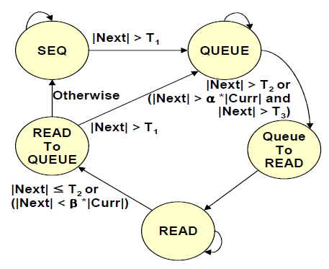
State machine implementation
Parallel Programming
Added arrow to be able to come back to Sequential state from Queue state:
Used only when dimention of Next is very small, useful for computation of last levels of RMAT that usually have a small amount of nodes.
|Next| < T₁
Small state machine:
Implemented as a switch case statement.
N.B. this is a heuristic approach, we do not know in advance for the current level which method performs better, but we can guess based on our experience.
POLITECNICO DI MILANO

Slide 14
ER Graph performances
Parallel Programming
POLITECNICO DI MILANO

Slide 15
ER Graph performances
Parallel Programming
POLITECNICO DI MILANO

Slide 16
RMAT Graph performances
Parallel Programming
POLITECNICO DI MILANO

Slide 17
RMAT Graph performances
Parallel Programming
POLITECNICO DI MILANO

